Slide 1
Odds Shark
Dive in at your own risk

Slide 2
Problems of the past…
Tracking down a bookie every time you want some action?
Keeping track of your bets?
Verifying your books against what your bookie shows?
Waiting for your bookie to get paid BEFORE you get paid?

Slide 4
What our service provides you…
A full list today’s games at the touch of your fingers
Ability to place a bet at anytime from anywhere
Up-to-date tracking of your ”wallet” and current bets
Payment on demand!!!

Slide 5
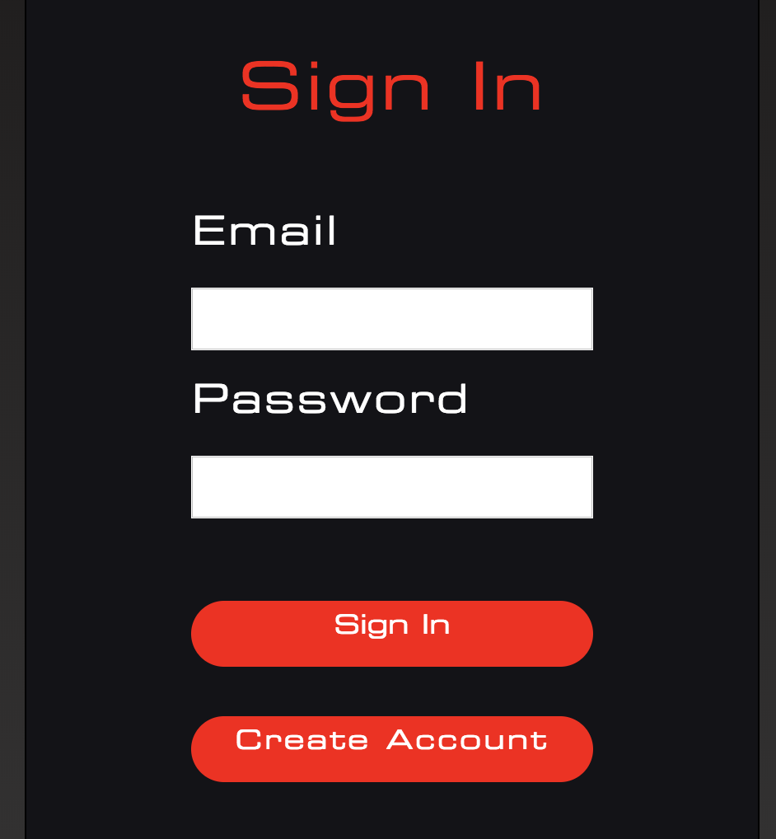
Trust the Process
“Passport”
“Flexbox”
“Handlebars”
User-authentication
User-interface
Html templates

